Slide 1

Subject Name:- Microprocessor & Microcontroller
Subject Code:- KEC-502
Unit No.:- 5
Lecture No.:- 2
Topic Name :- PUSH & POP, XCH Instruction and looping.
Er. Preeti Verma
ECE Department

Slide 2
PUSH & POP Instruction
STACK: It s part of RAM in which data will store temporary during execution of program. STACK work on last in first out principal.to store and retrieve data during program execution in stack push and pop instruction work for it.
PUSH: Its used to store data into stack.
POP: To retrieve data from stack.
SP: Stack pointer is 8 bit register which store value of top of the stack. By default stack pointer contain 07h.
PUSH: Using push operation stack pointer increased first and then content of register or memory will store on that stack location which stored in SP.

Slide 3
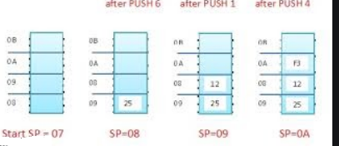
PUSH R6;SP increased by one and contain of R6 store into 08 location.
PUSH R1;SP increased again by one and contain of R1 stored into 09 location.
PUSH R4;SP increased again by one and contain of R4 stored into 0A location.
POP: In this retrieve data first and then stack pointer decreased by one. if we write POP 20h;then content at 0Ah location will copy into 20h then stack pointer decrease by 1. POP 21h;then content at 09h location will copy into 21h then stack pointer decrease by 1.

Slide 4
XCH Instruction
The XCH instruction loads the accumulator with the byte value of the specified operand while simultaneously storing the previous contents of the accumulator in the specified operand.
Opcode | Operand | Description
XCH A, | Rn | Exchange accumulator with Rn
 | @Ri | Exchange accumulator with indirect memory
 | address | Exchange accumulator with memory
The XCHD instruction exchanges the low-order nibble of the accumulator with the low-order nibble of the specified internal RAM location. The internal RAM is accessed indirectly through R0 or R1. The high-order nibbles of each operand are not affected. Ex- XCHD A, @Ri

Slide 5
Loop and Jump Instructions
Looping in the 8051
Repeating a sequence of instructions a certain number of times is called a loop.
An instruction DJNZ reg, label is used to perform a Loop operation. In this instruction, a register is decremented by 1; if it is not zero, then 8051 jumps to the target address referred to by the label.
The register is loaded with the counter for the number of repetitions prior to the start of the loop. In this instruction , the registers decrement and the decision to jump are combined into a single instruction.
The registers can be any of R0–R7. The counter can also be a RAM location.

Slide 6
Example
Multiply 25 by 10 using the technique of repeated addition.
Solution − Multiplication can be achieved by adding the multiplicand repeatedly, as many times as the multiplier. For example,
25 * 10 = 250(FAH)
25 + 25 + 25 + 25 + 25 + 25 + 25 + 25 + 25 + 25 = 250
MOV A, #0
MOV R2, #10
AGAIN: ADD A, #25
DJNZ R2, AGAIN
MOV R5,A

Slide 7
inside a Loop(Nested loop)
Looping action with the instruction DJNZ Reg label is limited to 256 iterations only.
Then we use a loop inside another loop, it is called a nested loop. Two registers are used to hold the count when the maximum count is limited to 256. So we use this method to repeat the action more times than 256.
Example
Write a program to −
Load the accumulator with the value 55H.
Complement the ACC 700 times.
Solution − Since 700 is greater than 255 (the maximum capacity of any register), two registers are used to hold the count. The following code shows how to use two registers, R2 and R3, for the count.

Slide 8
MOV A, #55H
MOV R3,#10
NEXT: MOV R2,#70
AGAIN: CPL A
DJNZ R2, AGAIN
DJNZ R3, NEXT

Slide 9
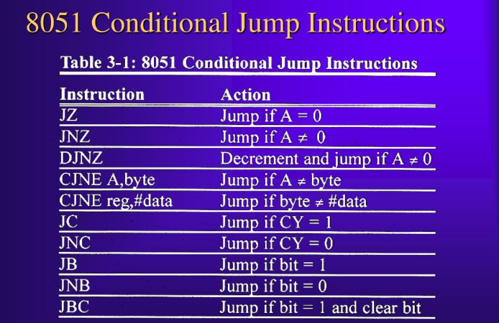
8051 Conditional Jump Instructions:
O
Note − It must be noted that all conditional jumps are short jumps, i.e., the address of the target must be within –128 to +127 bytes of the contents of the program counter.

Slide 10
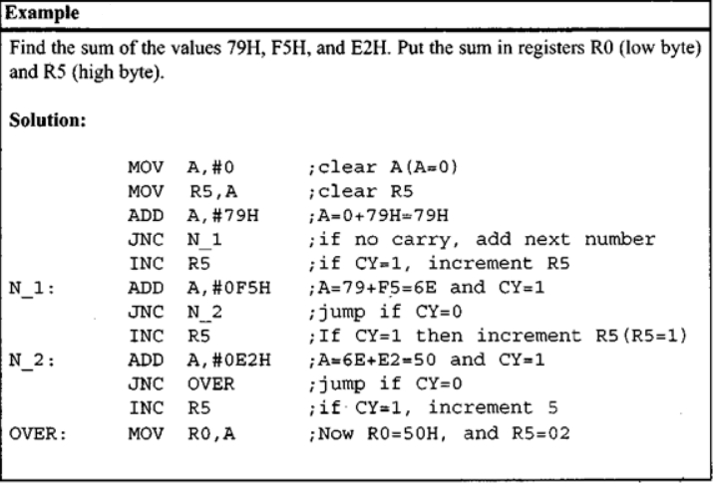

Slide 11
Unconditional Jump Instructions
There are two unconditional jumps in 8051 −
LJMP (long jump) − LJMP is 3-byte instruction in which the first byte represents opcode, and the second and third bytes represent the 16-bit address of the target location. The 2-byte target address is to allow a jump to any memory location from 0000 to FFFFH.
SJMP (short jump) − It is a 2-byte instruction where the first byte is the opcode and the second byte is the relative address of the target location. The relative address ranges from 00H to FFH which is divided into forward and backward jumps; that is, within –128 to +127 bytes of memory relative to the address of the current PC (program counter). In case of forward jump, the target address can be within a space of 127 bytes from the current PC. In case of backward jump, the target address can be within –128 bytes from the current PC.

Slide 12
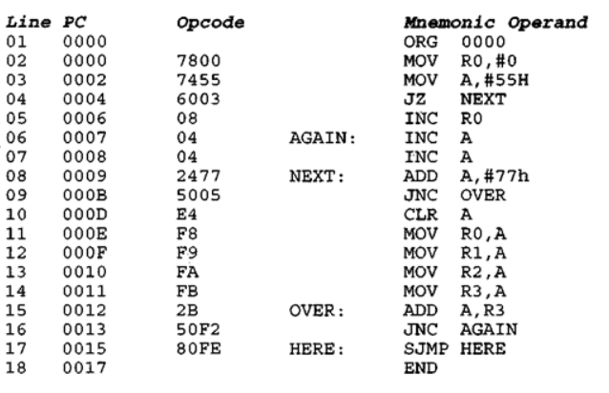
Calculating the short jump address In addition to the SJMP instruction, all conditional jumps such as JNC, JZ, and DJNZ are also short jumps due to the fact that they are all two-byte instructions. In these instructions the first byte is the opcode and the second byte is the relative address. The target address is relative to the value of the program counter. To calculate the target address, the second byte is added to the PC of the instruction immediately below the jump.

Slide 13
Solution:
First notice that the JZ and JNC instructions both jump forward.
The target address for a forward jump is calculated by adding the PC of the following instruction to the second byte of the short jump instruction, which is called the relative address.
In line 4 the instruction “JZ NEXT” has opcode of 60 and operand of 03 at the addresses of 0004 and 0005. The 03 is the relative address, relative to the address of the next instruction INC RO, which is 0006. By adding 0006 to 3, the target address of the label NEXT, which is 0009, is generated. In the same way for line 9.
The “JNC OVER” instruction has opcode and operand of 50 and 05 where 50 is the opcode and 05 the relative address. Therefore, 05 is added to GOOD, the address of instruction “CLR A”, giving 12H, the address of label OVER.

Slide 14
In that program list, “JNC AGAIN” has opcode 50 and relative address F2H. When the relative address of F2H is added to 15H, the address of the instruction below the jump, we have 15H + F2H = 07 (the carry is dropped). Notice that 07 is the address of label AGAIN.
Look also at ‘.’SJMP HERE”, which has 80 and FE for the opcode and relative address, respectively.
The PC of the following instruction, 0017H, is added to FEH, the relative address, to get 0015H, address of the HERE label (17H + FEH = 15H). Notice that FEH is -2 and 17H + (-2) = 15H

Slide 15
CALL Instructions
CALL is used to call a subroutine or method. Subroutines are used to perform operations or tasks that need to be performed frequently. This makes a program more structured and saves memory space. There are two instructions −
LCALL
ACALL.
LCALL (Long Call)
LCALL is a 3-byte instruction where the first byte represents the opcode and the second and third bytes are used to provide the address of the target subroutine. LCALL can be used to call subroutines which are available within the 64K-byte address space of the 8051.
To make a successful return to the point after execution of the called subroutine, the CPU saves the address of the instruction immediately below the LCALL on the stack.

Slide 16
Thus, when a subroutine is called, the control is transferred to that subroutine, and the processor saves the PC (program counter) on the stack and begins to fetch instructions from the new location.
The instruction RET (return) transfers the control back to the caller after finishing execution of the subroutine. Every subroutine uses RET as the last instruction.
ACALL (Absolute Call)
ACALL is a 2-byte instruction, in contrast to LCALL which is 3 bytes. The target address of the subroutine must be within 2K bytes because only 11 bits of the 2 bytes are used for address.
The difference between the ACALL and LCALL is that the target address for LCALL can be anywhere within the 64K-bytes address space of the 8051, while the target address of CALL is within a 2K-byte range.

Slide 17
Write a program to toggle all the bits by port one by sending the value 55H and AAH continuously . Put a time delay between each issuing a data to port1.
Main Program
BACK: MOV A,#55H
MOV P1,A
LCALL DELAY
MOV A,#AAH
MOV P1,A
LCALL DELAY
SJMP BACK
Subroutine
DELAY: MOV R4, #0FFH
BACK: DJNZ R4 BACK
RET

Slide 18
Important Questions
What is DJNZ in 8051?
What is looping in microprocessor?
What is control transfer instructions?
What is SJMP in 8051?
What are the 3 types of loops?

Slide 19
References
Text Books:
Mazidi Ali Muhammad, Mazidi Gillispie Janice, and McKinlay Rolin D., “The 8051 Microcontroller and Embedded Systems using Assembly and C”, Pearson, 2nd Edition,2006
Shah Satish, “8051 Microcontrollers MCS 51 Family and its variants”, Oxford,2010
Reference Books:
1. V. Udayashankara, M.S. Mallikajunaswamy, “8051 Microcontroller Hardware, Software and Applications”, McGraw-Hill, 2017

Slide 20
Thank You

